Slide 1
Evaluating AI for Voice Disorder Screening
From Research to Clinical Practice
6th of June 2025, Prague
31st Union of European Phoniatricians Congress
Mette Pedersen and Sneha Das
Pedersen, M.
MD, PhD, Ear-Nose-Throat Specialist, Head & Neck surgeon
Fellow of the Royal Society of Medicine UK
Danish Representative Union of European Phoniatricians
The Medical Center, Østergade 18, 1100 Copenhagen, Denmark
e-mail address: m.f.pedersen@dadlnet.dk
Phone: +45 31126184
Member UEP Biomarkers Committee
Sneha Das, Dsc. (Tech),
Assistant Professor,
Department of Applied Mathematics and Computer Science,
Technical University of Denmark, Denmark
sneha.das1991@gmail.com
+4591440864
Member UEP Biomarkers Committee
The Medical Center Østergade 18, 1100 Copenhaen, Denmark

Slide 2
We have no conflicts of interest

Slide 3
Why Voice-related Artificial Intelligence (Voice-AI) Matters in Healthcare
Voice-AI represents a rapidly advancing field of research that enables non-invasive, scalable methods for
voice disorders,
with Parkinson’s disease being a notable part in our library search on Voice-AI, by the Royal Society of Medicine Library UK.
However, adoption in clinical settings has seen limited clinical integration due to insufficient clinical evaluation.
The Medical Center Østergade 18, 1100 Copenhaen, Denmark

Slide 4
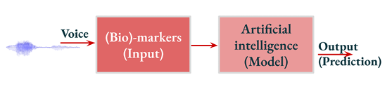
Components of a Voice-AI System
The schematic illustrates the fundamental components of a minimal Voice-AI system.
It maps the input audio signal through pre-processing and modeling to generate outputs such as: diagnostic classifications or quantitative scores.
Das S. Presentation: (Bio)-markers and AI in Voice Disorders (Parkinson’s Disease): Opportunities and Challenges. May 20th 2025. Committee of Voice Related Biomarkers, Union of European Phoniatricians.
The Medical Center Østergade 18, 1100 Copenhaen, Denmark

Slide 5
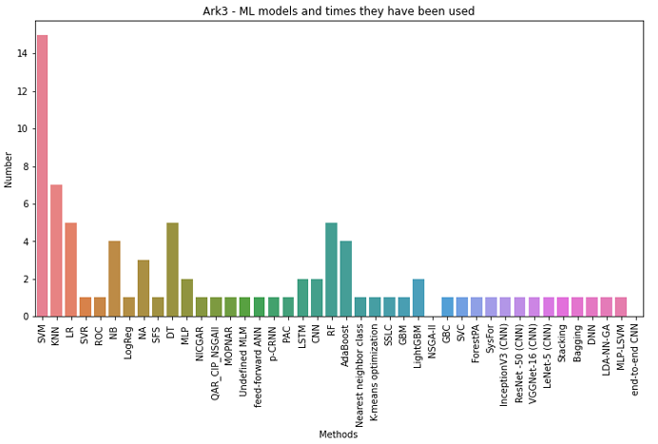
Voice-AI models encompass both classical statistical techniques and advanced deep learning architectures.
This figure provides an overview of models applied across the 19 Parkinson ’s-related studies (search of Voice-AI by the Royal Society of Medicine, UK, 2013-2023).
Das S. Presentation: (Bio)-markers and AI in Voice Disorders (Parkinson’s Disease): Opportunities and Challenges. May 20th 2025. Committee of Voice Related Biomarkers, Union of European Phoniatricians.
The Medical Center Østergade 18, 1100 Copenhaen, Denmark

Slide 6
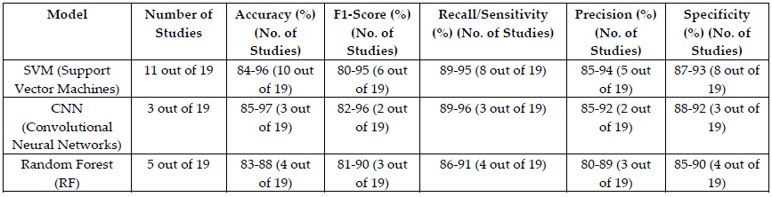
Model Performance –
This table compares critical model performance across the 19 studies. Support Vector Machines (SVMs), CNNs, and Random Forests demonstrated robust accuracy and sensitivity, although performance varied regarding precision and F1.
(not all articles give detailed data)
Models information across studies.
Pedersen M, Meiner VG. AI-Based Quality of Voice Analysis Models for Clinical Use, Insights of Quality of Models from 19 Parkinson’s Disease Studies (2013-2023). Journal of Clinical Medical Research - Year 2024, Vol 6, Issue 1. https://doi.org/10.46889/JCMR.2025.6107
The Medical Center Østergade 18, 1100 Copenhaen, Denmark

Slide 7
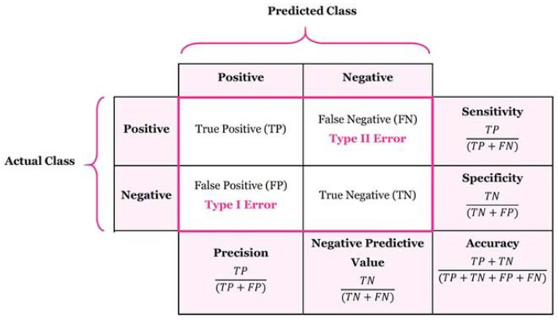
Confusion Matrix and Its Importance
The confusion matrix facilitates contextual interpretation of accuracy metrics. High accuracy may yield misleading conclusions in imbalanced datasets unless paired with sensitivity, specificity, and precision.
Confusion matrix.
Pedersen M, Meiner VG. AI-Based Quality of Voice Analysis Models for Clinical Use, Insights of Quality of Models from 19 Parkinson’s Disease Studies (2013-2023). Journal of Clinical Medical Research - Year 2024, Vol 6, Issue 1. https://doi.org/10.46889/JCMR.2025.6107
The Medical Center Østergade 18, 1100 Copenhaen, Denmark

Slide 8
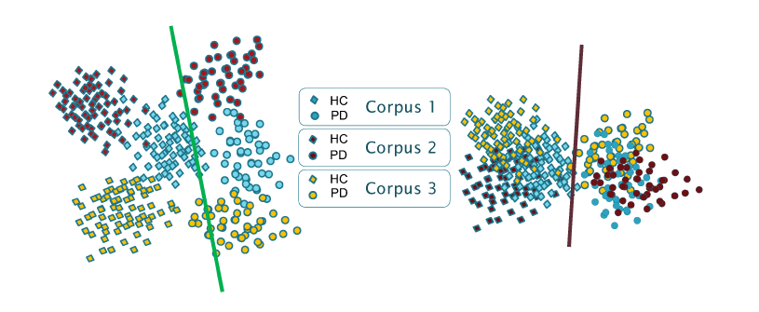
Evaluation Metrics for Classification
For classification tasks, such as distinguishing between Healthy Controls (HC) and patients with Parkinson’s Disease (PD), we assess model performance using standard metrics including accuracy, recall, and the F1-score
Metrics for classification
Ibarra EJ, Arias-Londoño JD, Zañartu M, Godino-Llorente JI. Towards a corpus (and language)-independent screening of parkinson’s disease from voice and speech through domain adaptation. Bioengineering. 2023 Nov 15;10(11):1316.
The Medical Center Østergade 18, 1100 Copenhaen, Denmark

Slide 9
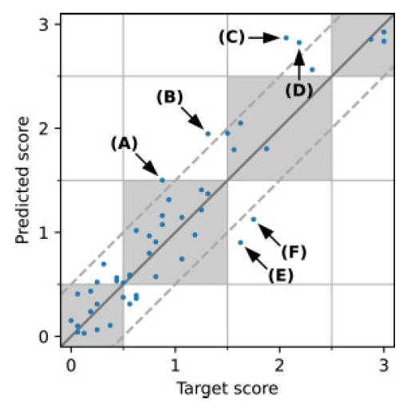
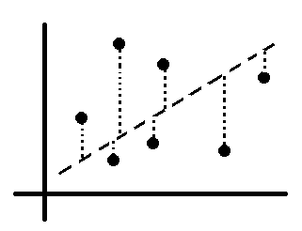

Evaluation Metrics for Regression
When predicting continuous scores like GRBAS ratings, we use regression metrics like Mean Squarred Error (MSE): $\frac{1}{N}\sum_{i=1}^{N}{{\left(y_{i}−{\hat{y}}_{i}\right)}^{2}}$ and Coefficient of Determination R².
MSE is the average squared distance between predicted and actual values, penalizing large errors more heavily.
Points within the shaded regions show predictions within ±1 of the true score. Labeled examples (A–F, see below) highlight typical error types.
R² indicates how well the model explains the variability in the target scores — with 1 being a perfect fit and 0 meaning no predictive power.
Regression metrics.
Example of MSE
Hidaka S, Lee Y, Nakanishi M, Wakamiya K, Nakagawa T, Kaburagi T. Automatic GRBAS scoring of pathological voices using deep learning and a small set of labelled voice data. Journal of Voice. 2022 Nov 25.
The Medical Center Østergade 18, 1100 Copenhaen, Denmark

Slide 10
The 19 articles on Voice - AI in Parkinsons Disease
Category | Problems Identified | Articles That Provide Data | Articles That Do Not Provide Data | Reason for Missing Data
Usability | Insufficient dataset size | 6 articles | 12-13 articles | Articles focus on model performance
Precision | Variability in measurement protocols | 5 articles | 13-14 articles | Many articles assume standardized datasets
Content | Limited diversity in vocal tasks | 7 articles | 11-12 articles | Studies focus on specific phonemes
Population | Underrepresentation of demographic groups | 4-5 articles | 13-15 articles | Articles do not address demographic diversity
Disorder Characteristics | Limited characterization of specific vocal imparimetns | 6 articles | 12-13 articles | Some studies focus purely on classification
Methodological limitations in the Voice-AI papers include
lack of demographic diversity,
insufficient dataset size, and
incomplete metric reporting.
These limit real-world relevance.
(not all papers give sufficient data)
Acoustical Dataset
Pedersen M. (2025). Artificial Intelligence for Screening Voice Disorders: Aspects of Risk Factors : Research Article. American Journal of Medical and Clinical Research & Reviews, 4(2), 1–8. https://doi.org/10.58372/2835-6276.1254
The Medical Center Østergade 18, 1100 Copenhaen, Denmark

Slide 11
The 19 articles on Voice - AI in Parkinson’s Disease
Category | Challenges Identified | Articles That Provide Data | Articles That Do Not Provide Data | Reason for Missing Data
Microphone Placement | Distance of the microphone was identified as a challenge | 5 articles | 14 articles | Many articles assume ideal recording conditions
Noise Factors | Environmental noise variability | 6 articles | 12-13 articles | Articles often assume noise-free environments
Measurement Parameters | Frequency area measurement inconsistencies | 4 articles | 14-15 articles | Many studies do not report detailed frequency analysis
Feature Extraction | Challenges in signal processing | 7 articles | 11-12 articles | Some articles focus on algorithm testing or dataset creation without detailing feature extraction.
Challenges in Acoustic Data Processing (note that not all give sufficient data)
Pedersen M. (2025). Artificial Intelligence for Screening Voice Disorders: Aspects of Risk Factors : Research Article. American Journal of Medical and Clinical Research & Reviews, 4(2), 1–8. https://doi.org/10.58372/2835-6276.1254
The Medical Center Østergade 18, 1100 Copenhaen, Denmark

Slide 12
The 19 articles on Voice - AI in Parkinson’s disease
Evaluation Criteria | Articles That Provide Data | Articles That Do Not Provide Data | Measurement Description
Sensitivity (recall) | 7 articles | 11-12 articles | Sensitivity ranged from 73% to 95%
Specificity | 7 articles | 11-12 articles | Specificity ranged from 60% to 96%.
Accuracy | 6 articles | 12-13 articles | Accuracy ranged between 84% and 96%
Cross-Validation | 8 articles | 10-11 articles | Common validation techniques included 10-fold cross-validation
Training Setup | 7 articles | 11-12 articles | An 80:20 split for training and testing was most common
Testing Setup | 6 articles | 12-13 articles | Evaluation metrics included F1-scores: 0.75–0.79
AI Model Choice & Description | 7 articles | 11-12 articles | Popular models included SVM, CNN, and AdaBoost
Evaluation Metrics and Frameworks for Parkinson’s Disease Models. (Note that not all give sufficient data)
Pedersen M. (2025). Artificial Intelligence for Screening Voice Disorders: Aspects of Risk Factors : Research Article. American Journal of Medical and Clinical Research & Reviews, 4(2), 1–8. https://doi.org/10.58372/2835-6276.1254
The Medical Center Østergade 18, 1100 Copenhaen, Denmark

Slide 13
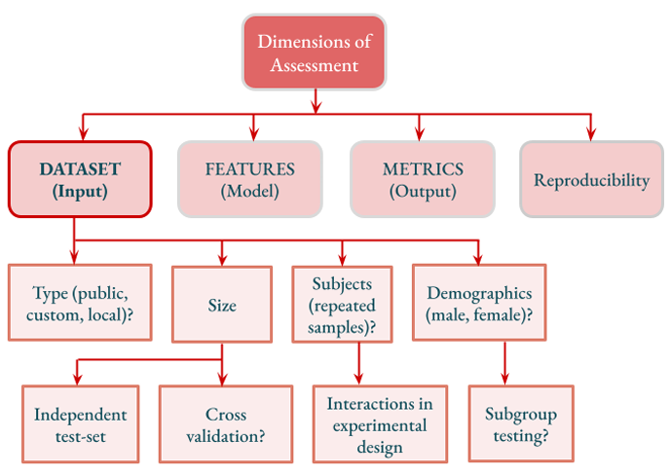
Dataset and Quality Challenges
Data quality and distribution heavily impact AI performance. Inadequate microphone positioning, background acoustic interference, and non-representative data distributions can all introduce bias and reduce generalizability.
Flow diagram depicting the sub-factors under the datasets that influences model choices.
Das S. Presentation: (Bio)-markers and AI in Voice Disorders (Parkinson’s Disease): Opportunities and Challenges. May 20th 2025. Committee of Voice Related Biomarkers, Union of European Phoniatricians.
The Medical Center Østergade 18, 1100 Copenhaen, Denmark

Slide 14
Foundation Models – The Next Step?
Emerging foundation models such as GPT or BERT hold transformative potential voice-AI by enabling multi-task learning.
Their adaptation to voice-related biomarkers is currently underexplored or in early investigational phases.
The Medical Center Østergade 18, 1100 Copenhaen, Denmark

Slide 15
🧬 4
A foundation model trained on voice-related biomarkers
Voice Handicap Index SCORES
GRBAS (or CAPE – V)listening TEST
Acoustic parameters (F0, jitter, shimmer, Harmonics Noise Ratio), and
Maximun Phonation Time
could learn powerful representations of vocal health and impairment.
Here's what such a model could conclude or infer depending on its design and the task it's fine-tuned for:
5

Slide 16
Example Tasks Enabled by the Multiple Layer Perception Foundation Model
Task | Input | Output
Voice disorder screening | Audio + MPT | Binary or multiclass label
Automatic perceptual scoring | Audio | GRBAS or CAPE-V scores
Predict VHI | Audio + demographic info | VHI-10 score
Track therapy effect | Audio over time | Time-series of severity
Voice health embedding generation | Raw or processed audio | Fixed-size vector

Slide 17
Clinical Readiness and EU AI Act
Quantitative performance metrics alone are insufficient for determining clinical applicability.
Regulatory frameworks like the EU AI Act stress explainability, robustness, and real-world validation.
The integration of AI applications in clinical practice remains subject to ongoing regulatory and practical evaluation.
Gstrein, O. J., Haleem, N., & Zwitter, A. (2024). General-purpose AI regulation and the European Union AI Act. Internet Policy Review, 13(3). https://doi.org/10.14763/2024.3.1790
The Medical Center Østergade 18, 1100 Copenhaen, Denmark

Slide 18
Limitations and Open Questions
Despite its promise, Voice-AI remains hindered by a lack of standardized protocols and robust clinical trials. Trust, transparency, and diverse data remain key barriers.
The Medical Center Østergade 18, 1100 Copenhaen, Denmark

Slide 19
Conclusion & Path Forward
To make AI for voice disorders viable in clinics, it is imperative to design updated, reliable systems
with input from both
data scientists and clinical stakeholders,
but with direct input from clinicians and patients.
The Medical Center Østergade 18, 1100 Copenhaen, Denmark

Slide 20


Acknowledgements
Thank you to Vitus Girelli Meiner, MSc. in Computer Science,
IT-University of Copenhagen, Denmark
Vigga Girelli Meiner, High School Graduate,
Gefion Gymnasium, Denmark
No conflict of interest
Thank you for listening!
The Medical Center Østergade 18, 1100 Copenhaen, Denmark

Slide 21
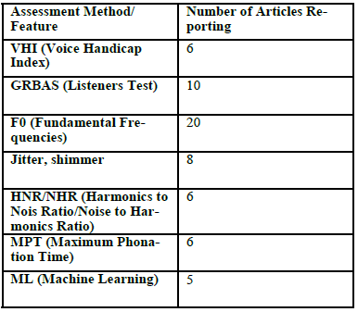
Biomarker-Based Evaluation
This table lists key voice biomarkers used in genetic disorder studies. F0, jitter, and MPT are central, but many studies are still in early stages of clinical relevance.
Frequency of Voice-Related Parameters in Papers on Genetics in the Last 5 Years
Pedersen M. (2025). Artificial Intelligence for Screening Voice Disorders: Aspects of Risk Factors : Research Article. American Journal of Medical and Clinical Research & Reviews, 4(2), 1–8. https://doi.org/10.58372/2835-6276.1254
The Medical Center Østergade 18, 1100 Copenhaen, Denmark

Slide 22
The Role of Optical Coherence Tomography (OCT)
Optical Coherence Tomography (OCT) provides a non-invasive modality to visualize vocal fold tissue, useful for tracking puberty, hormones, and voice recovery after injuries or radiation exposure.
Three boys average Voice Range Profiles and standard deviations for the highest and lowest tones
Pedersen M. Tissue Analysis of the Vocal Folds Cellular and Biochemical Aspects. J Biomed Res Environ Sci. 2025 Feb 18; 6(1): 153-156. doi: 10.37871/jbres2067
The Medical Center Østergade 18, 1100 Copenhaen, Denmark

Slide 23
Overview of a foundation model
🔧 Objective
🪜 Steps to Build the MLP Model
Collect Data
  Each sample = [MPT, F0, jitter, shimmer, HNR] + severity label
  Labels: “Mild”, “Moderate”, “Severe”
Extract Features
  Use tools like Praat, openSMILE, or Librosa
  Normalize features for model input
Define the Model (MLP)
  Input layer: 5 features
  Hidden layers: 1–2 (e.g., 32 → 16 neurons)
  Output layer: 3 neurons (one per class)
  Activation: ReLU
  Output: Softmax → probabilities per class
Train the Model
  Loss function: CrossEntropyLoss
  Optimizer: Adam
  Input: feature vectors
  Target: class labels
Deploy
  Use model in a clinical app or desktop tool
  Input features during laryngoscopy
  Output severity level in real time
🧠 Why Use MLP?
Simple, fast, and effective for tabular clinical data
Can integrate with real-time systems
Works well even without raw audio if features are accurate

